Slide 1
NE 795-014: Advanced Reactor Materials
Fall 2023
Dr. Benjamin Beeler

Slide 2
Housekeeping
No office hours next week (on travel)
Presentation info:
one presentation modification won out
Due date: Nov. 6; presentations on 7th and 9th
Slides submitted via moodle
20 minute presentation (hard limit)
Examination of topic: background, relevance, latest research, etc.
Provide a list of references as a supplementary slide
Grade based upon technical content, organization, logic flow, etc.

Slide 3
Last Time
MOX fuels for SFRs
MOX restructures into four regions, driven by very high temperatures
central void, columnar grains, large equiaxed, as-fab grains
Pu and actinides migrate toward central pore, U away, due to condensation/evaporation pore migration
Oxygen also moves down T gradient
JOG and FCCI are critical phenomena
High O potential at fuel surface allows for JOG formation (Cs-Mo-O) and for FCCI phases (Cs-Cr-O) to form
MOX fuels are fabricated with low O content

Slide 4
Sodium coolant

Slide 5
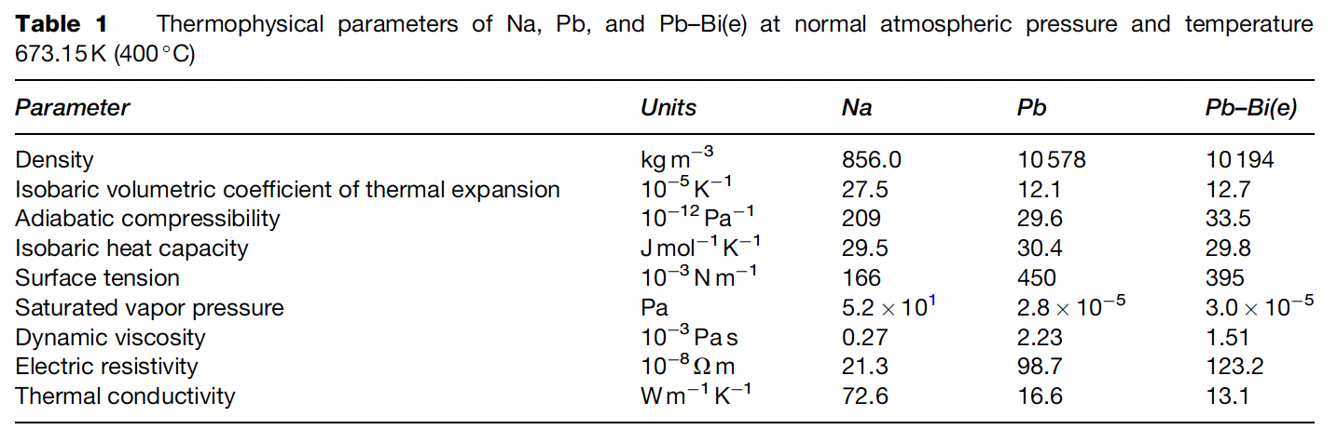
Liquid Metal Coolants
Liquid metals (LM), such as sodium (Na), lead (Pb), and lead–bismuth (Pb–Bi) eutectic, are considered as potential coolants for the fast spectrum nuclear reactors of the next generation
The main advantages of Na coolant in comparison with Pb are the lower melting temperature, density and dynamic viscosity and the higher thermal and electrical conductivities

Slide 6
Sodium
Sodium is a solid at room temperature; melting point is 98 C; boiling point is 881 C
Therefore, sodium is in the liquid phase at FR operating temperatures without pressurization
For this reason, it is not necessary to adopt the pressurized design employed in light water reactors for SFRs
Sodium is a great heat transfer medium due to high thermal conductivity, high heat capacity, and large liquid range
Allows for high power density core and low coolant fraction
Na has insignificant neutron moderation, making it suitable for the coolant for the FBR
The weakness of sodium as a coolant is its reactivity with oxygen and/or water

Slide 7
Structural Material Selection for Na
It is necessary to take the environment into consideration by estimating the mechanical properties and thermal characteristics
Environments specific to the SFR components include: (a) contact with the coolant, (b) high temperature at which the creep effects must be taken into account, and (c) neutron irradiation
The dissolution of elements contained in the material, such as iron, chromium, and nickel, in sodium and the reverse phenomenon (deposition) occur on the material surface due to the difference in chemical potential
The behavior is fundamentally controlled by the solubility of the material elements in sodium and by the diffusion rate of the materials

Slide 8
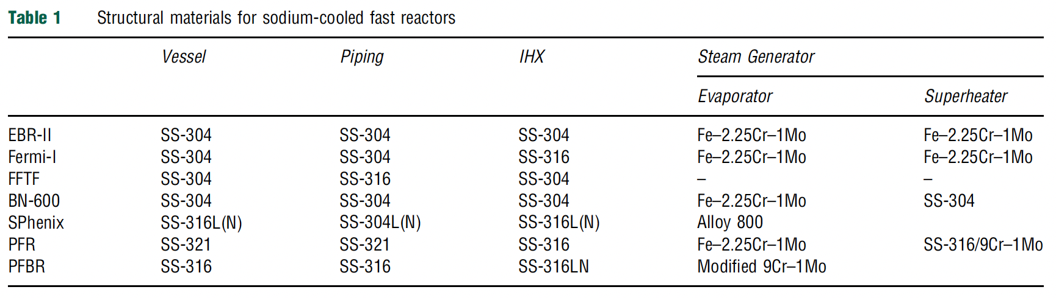
Structural Materials in SFRs
Austenitic and ferritic/martensitic steels are two key alloy classes for SFR structural materials
Most research has been done on SS-304 and SS-316, but advanced alloy behavior (T91, ODS steels, etc.) is being studied

Slide 9
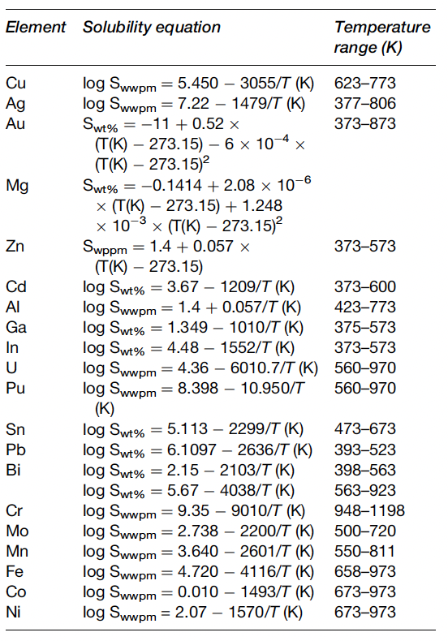
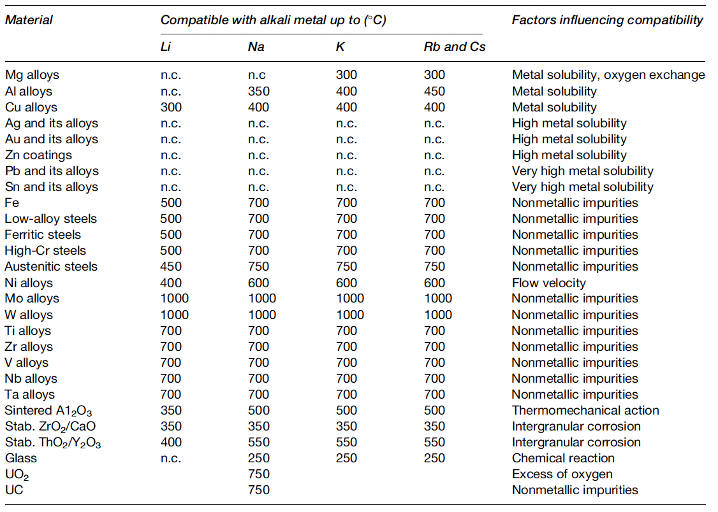
Solubilities and Compatibility
Among the elements in austenitic stainless steel, the solubility of nickel is greatest
Therefore, the phase transformation of austenite to ferrite through nickel dissolution is observed on the surface in long-term immersion in sodium

Slide 10
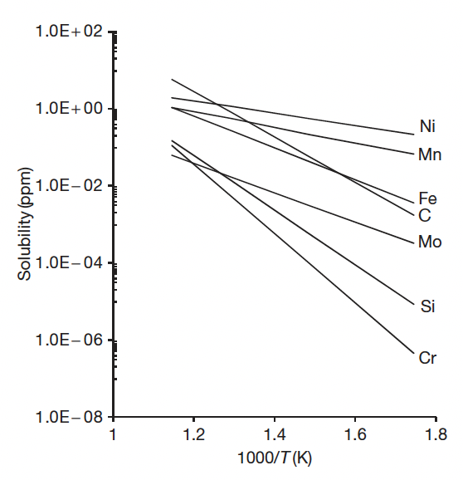
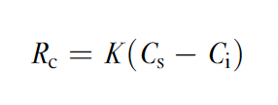
Sodium Corrosion
There are two known mechanisms of sodium corrosion
Type I: corrosion produced by the dissolution of alloy elements to sodium
Type II: corrosion produced through chemical reaction with the impurities in sodium
Type I corrosion is dependent on the solubility in sodium of the elemental composition in the material, temperature, and the rate of solution
K is the solution rate constant, Cs is the solubility limit in sodium, and Ci is the actual concentration in sodium

Slide 11
Sodium Corrosion
The solubility of each of the primary components of stainless steel in sodium at 550 C is less than a few parts per million
This means that the nominal compatibility of the steels with sodium is excellent
In the isothermal sodium condition, the corrosion of the steels stops when the dissolved elements reach saturation concentration at the temperature of sodium
This corrosion behavior is called thermal gradient mass transfer under non-isothermal conditions
In the cooling system, the elements in the materials in the high-temperature section dissolve as a result of the temperature dependency of the solubility of the elements in sodium, and the dissolved elements are deposited on the steel surface in the low-temperature section by the same mechanism

Slide 12
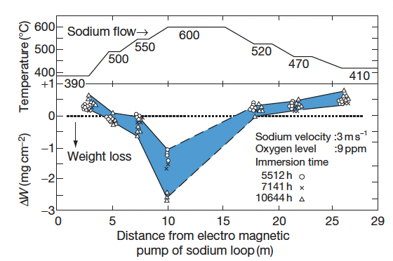
Sodium Corrosion
The results of thermal gradient mass transfer using a sodium loop made of 316SS
The weight loss caused by the dissolution of the elements in the steel is measured in the high-temperature section, and the weight gain caused by the deposit of the dissolved elements in sodium is observed in the low-temperature section

Slide 13
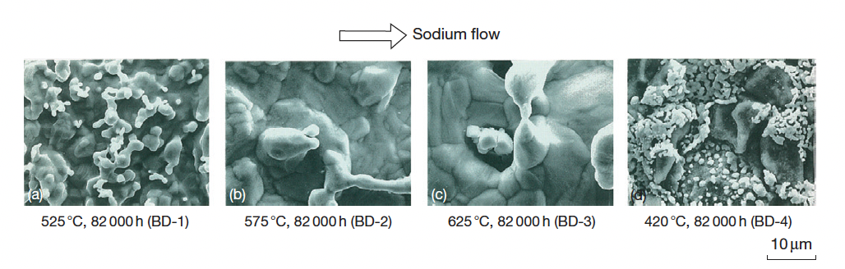
Sodium Corrosion
Dissolution of the elements in the material is observed in the high-temperature section, and precipitation is observed in the low-temperature section

Slide 14
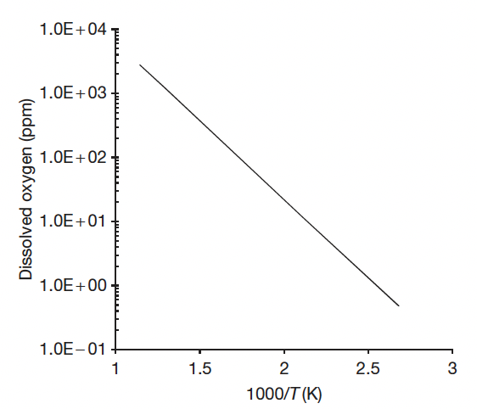
Impurity Sodium Corrosion
Type II-Corrosion Produced Through Chemical Reaction with the Impurities in Sodium
The control of impurities in sodium can be achieved by using techniques to deposit the dissolved impurities in sodium
Impurities such as oxygen, carbon and nitrogen in sodium can have a strong effect on the corrosion rate of a material
Sodium is the reducing agent, and its affinity to oxygen is very strong
The solubility of oxygen in sodium is significantly higher than in water

Slide 15
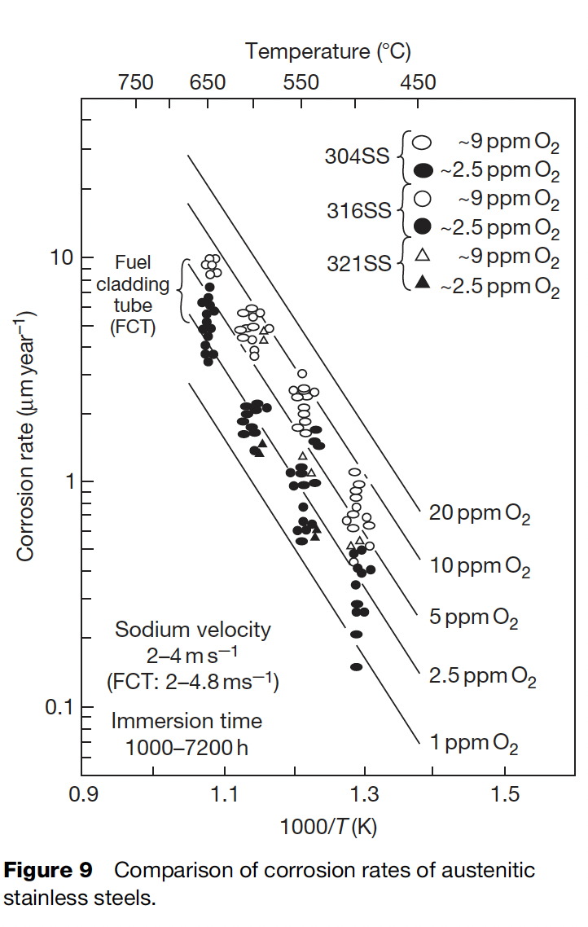
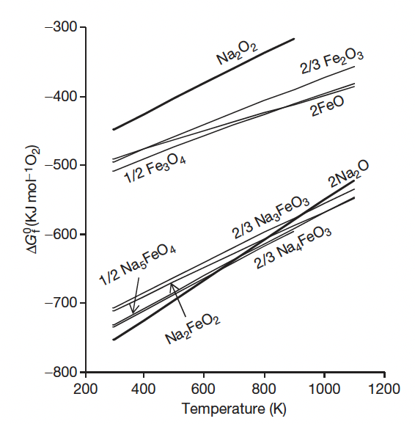


Oxygen Acceleration
The introduction of oxygen into sodium may occur during refueling, supplementing of the reactor cover gas, opening of the coolant boundary for maintenance operations, etc.
The thermodynamically stable oxide in sodium is sodium oxide, Na2O
Fe spontaneously reacts with Na2O above 380C, forming Na4FeO3
These reactions increase the effective solubility of Cr/Fe in Na

Slide 16
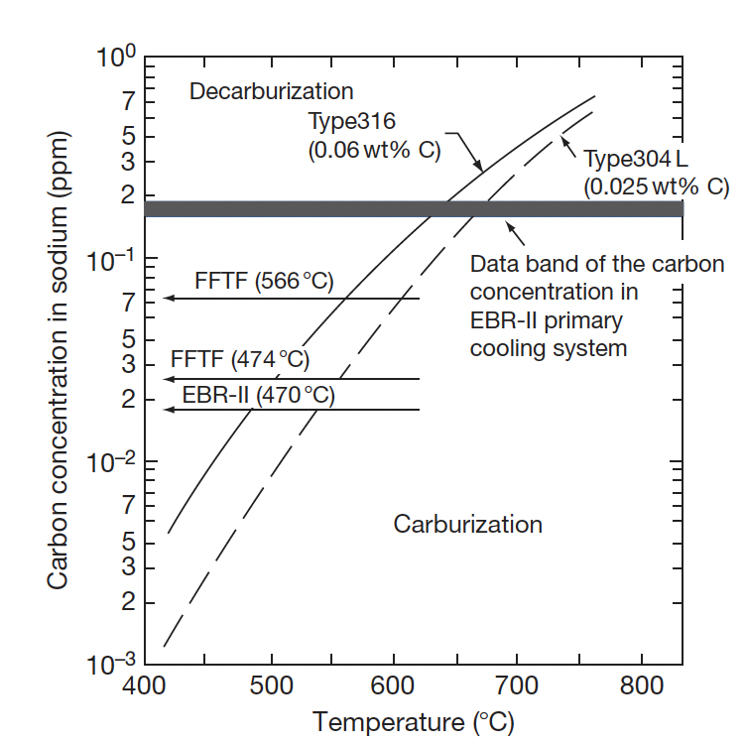
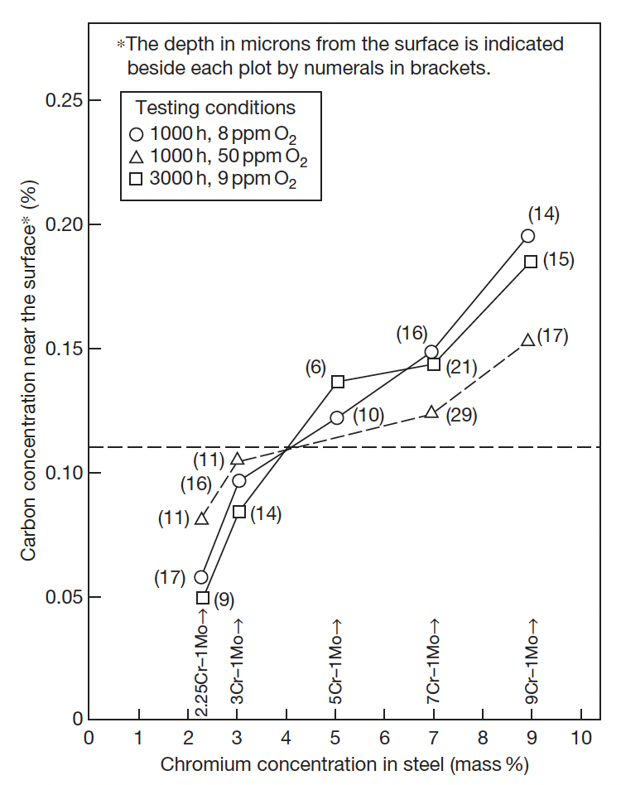
Carbon Effects
Carbon is an important element in maintaining the superior mechanical strength of steel
Carbon transfer can occur due to the chemical activity difference resulting from the temperature gradient
The materials located in the high temperature regions tend to decarburize
If a system has both austenitic and ferritic steels, carbon transfer can occur due to different chemical activities in these materials; austenitic steels carburize
High Cr content reduces susceptibility for decarburization, largely through forming Cr-C precipitates

Slide 17
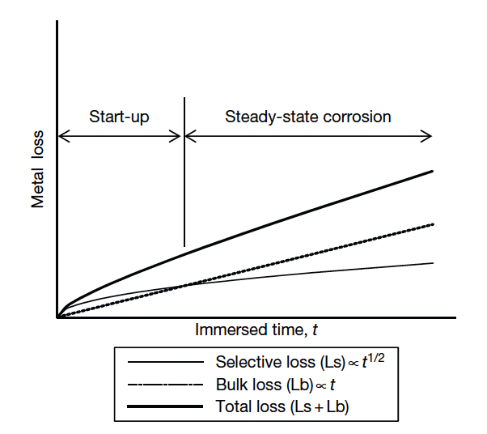
Na Corrosion of Austenitic Steel
The important factors which influence the corrosion of the steels in sodium are: (1) immersion time, (2) temperature, (3) dissolved oxygen, (4) sodium velocity, (5) alloy elements, and (6) carburization and decarburization
Ni and Mn have high Na solubilities and dissolve first in selective (start-up) corrosion, whereas Fe corrodes in general (steady-state) corrosion

Slide 18
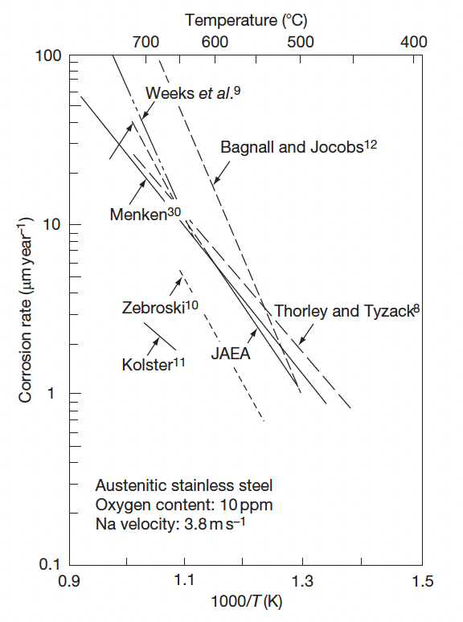
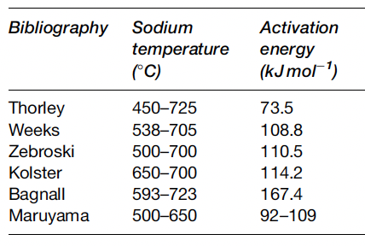
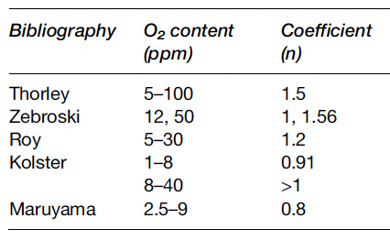
Na Corrosion of Austenitic Steel
Corrosion rate follows an Arrhenius function
The effective activation energy is a function of temperature, and agrees with the activation energy of solubility in Na
This matches the understanding of corrosion through dissolution processes
The corrosion rate is proportional to the oxygen concentration to a power n~1
Thus, limiting O2 in the Na can limit corrosion
Corrosion rates increase with velocity up to a certain point, then become velocity independent

Slide 19
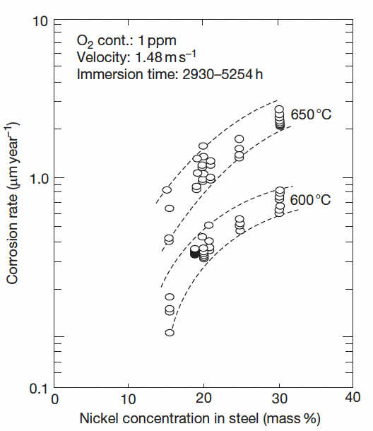
Na Corrosion in Austenitic Steel
Because this is a dissolution driven process, the alloying elements are key to corrosion rates
Ni is especially soluble in Na, and as Ni content increases, corrosion rates increase
Cr has a much low solubility in Na and is thus preferred as an alloying element for Na-facing components
Decarburization or steels can also occur due to the temperature-dependent solubility of C in Na

Slide 20
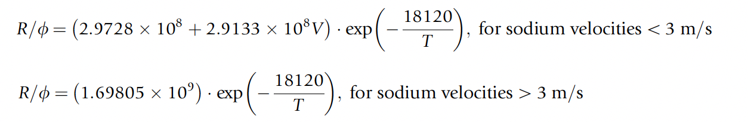
Na Corrosion in Austenitic Steel
Corrosion behavior of austenitic stainless steels is well understood over the temperature range of 455–755 C
It is known that after the initial period of exposure, steady-state corrosion is reached, which governs the long-term corrosion behavior
Have relationships for corrosion which include flow velocity, oxygen content, and temperature

Slide 21
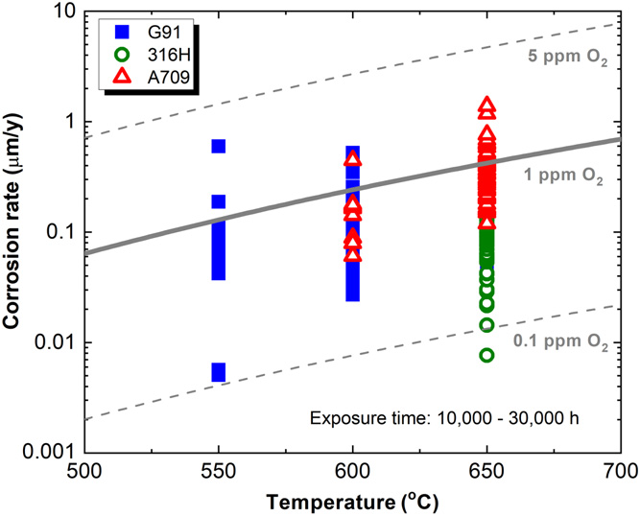
Na Corrosion in Ferritic Steels
Also sensitive to temperature, oxygen content, and Na flow velocity
Low-Cr steels show weight loss and decarburization, while high-Cr steels show weight gain and carburization
Oxygen content tends to increase corrosion rates
Flow velocity effects taper above 7 m/s, higher than in austenitic steels
In general, effects of corrosion in F/M steels are similar to austenitic steels, but with different chemical components

Slide 22
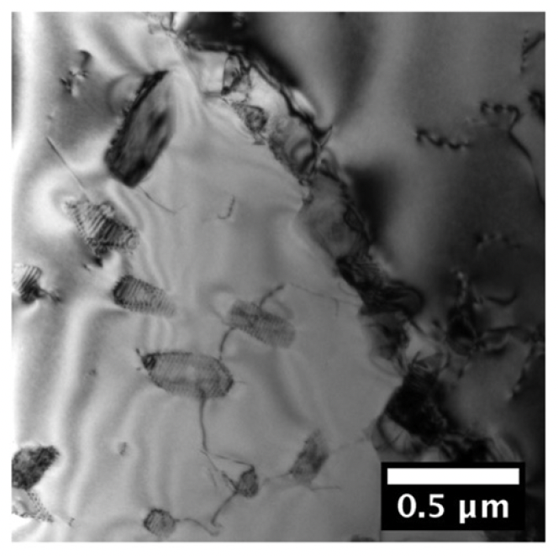
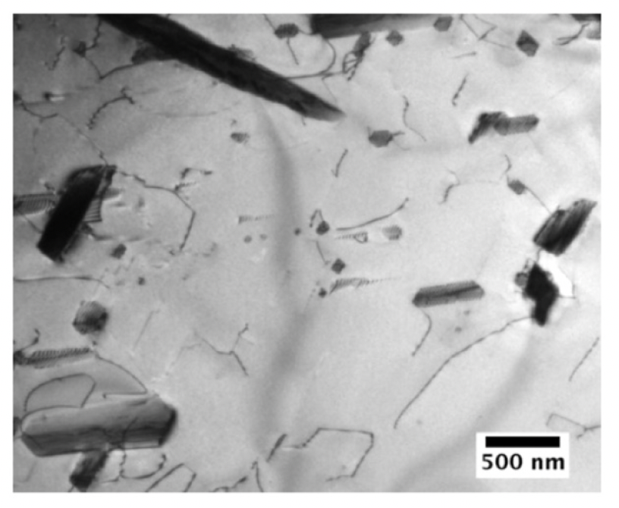
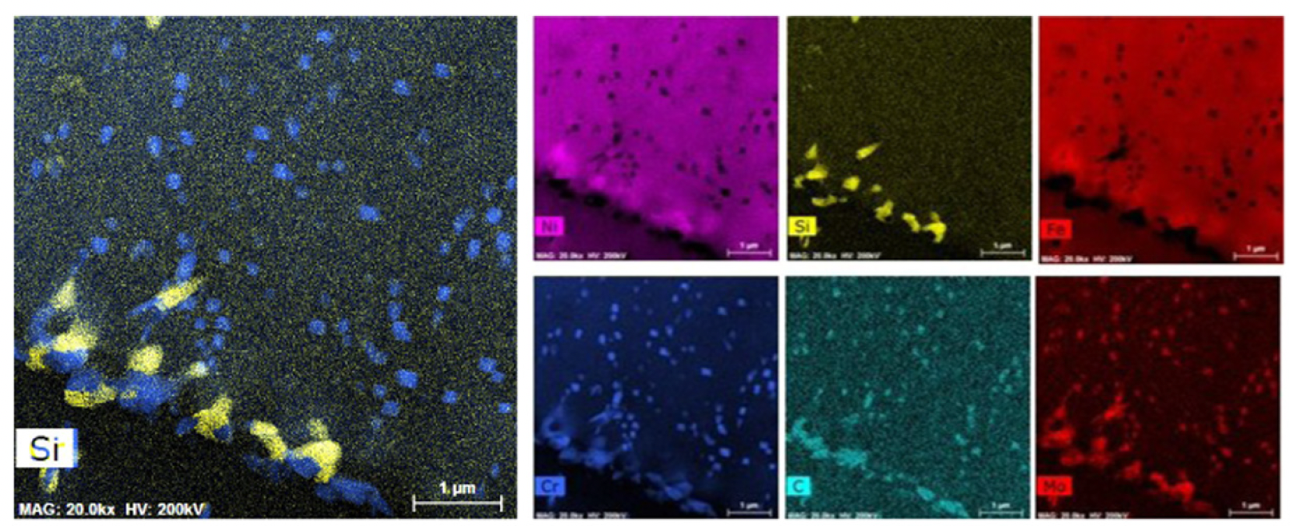
Effects on Microstructure
Austenitic steels exposed to Na see an increase in the M23C6 carbide precipitates, as well as Laves phases, both intra and intergranularly
Ferritic martensitic steels exposed to sodium can see a reduction in dislocation density, sub-grain coarsening, carbide coarsening, and precipitation of Laves phases

Slide 23
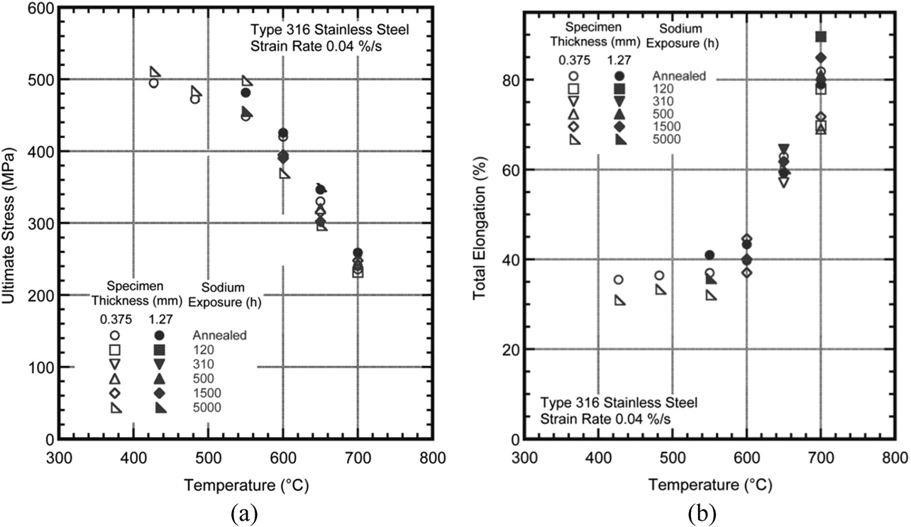
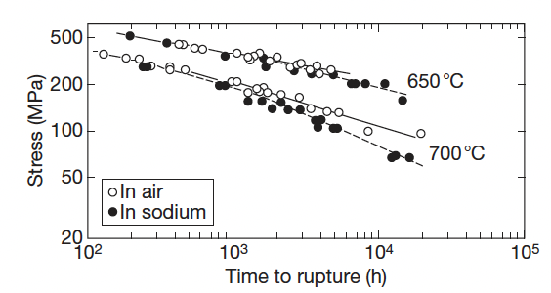
Effects on Mechanical Properties
The effect of sodium on the mechanical strength of steel is determined by three factors: (a) corrosion and mass transfer, (b) decarburization and carburization, and (c) oxidation/reduction
Since the cladding tubes are thin components and are exposed to high temperatures, the sodium corrosion affecting the base metal is larger than that of the structural materials
Minor impacts on tensile strength, elongation, and creep strength for Na vs air
Slight improvement in creep fatigue in sodium compared to air
Creep Strength

Slide 24
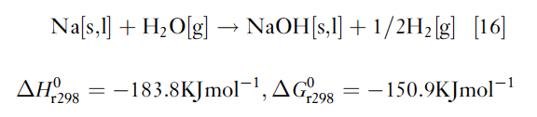
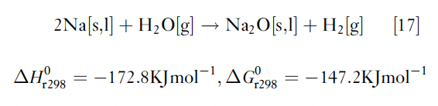
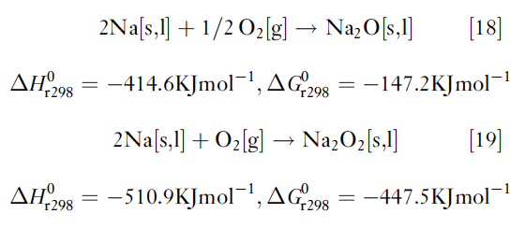
Na-Water/Air Reactions
One of the weak points of the present SFRs is the steam generator
If the steam generator tube is damaged, high-temperature pressurized steam is blown into the sodium
The environment around the failed tube is heated to high temperature (potentially up to 1200C) due to exothermic reactions
When high-temperature sodium is leaked into the atmosphere, it reacts with oxygen, and sodium oxides are formed

Slide 25
Summary
Na is used as a coolant due to high thermal conductivity, high heat capacity, high margin to boiling
There are two known mechanisms of sodium corrosion: Type I: corrosion produced by the dissolution of alloy elements to sodium; Type II: corrosion produced through chemical reaction with the impurities in sodium
Temperature gradient mass transfer is of high concern, based upon solubilities of steel elements, and highly impacts Ni
(De)carburization can occur, but can be limited with high Cr content
Oxygen accelerates corrosion by increasing effective solubilities
Sodium modified the microstructure of steels through precipitation, coarsening, etc.
Mechanical properties and minimally impacted by Na exposure

Slide 26
Questions?

Slide 27
Concluded SFRs
Quiz on SFR lectures on October 5 (next Thursday)
No office hours next Wednesday because I am out of town
Supplemental office hours will be held at 11am on Tuesday, just in case

